Slide 1

Rockbuster Stealth LLC online video rental launch strategy
Presentation by
Chloe Hangartner

Slide 2
Overview
Rockbuster Stealth LLC is a movie rental company that used to have stores around the world. Facing stiff competition from streaming services such as Netflix and Amazon Prime, the Rockbuster Stealth management team is planning to use its existing movie licenses to launch an online video rental service in order to stay competitive.

Slide 3
Key Business Questions
What are the most and least popular movies genres?
What is the most common rating of a movie rental?
What countries do Rockbuster customers live in?
Who are the top customers, and where do they live?

Slide 4
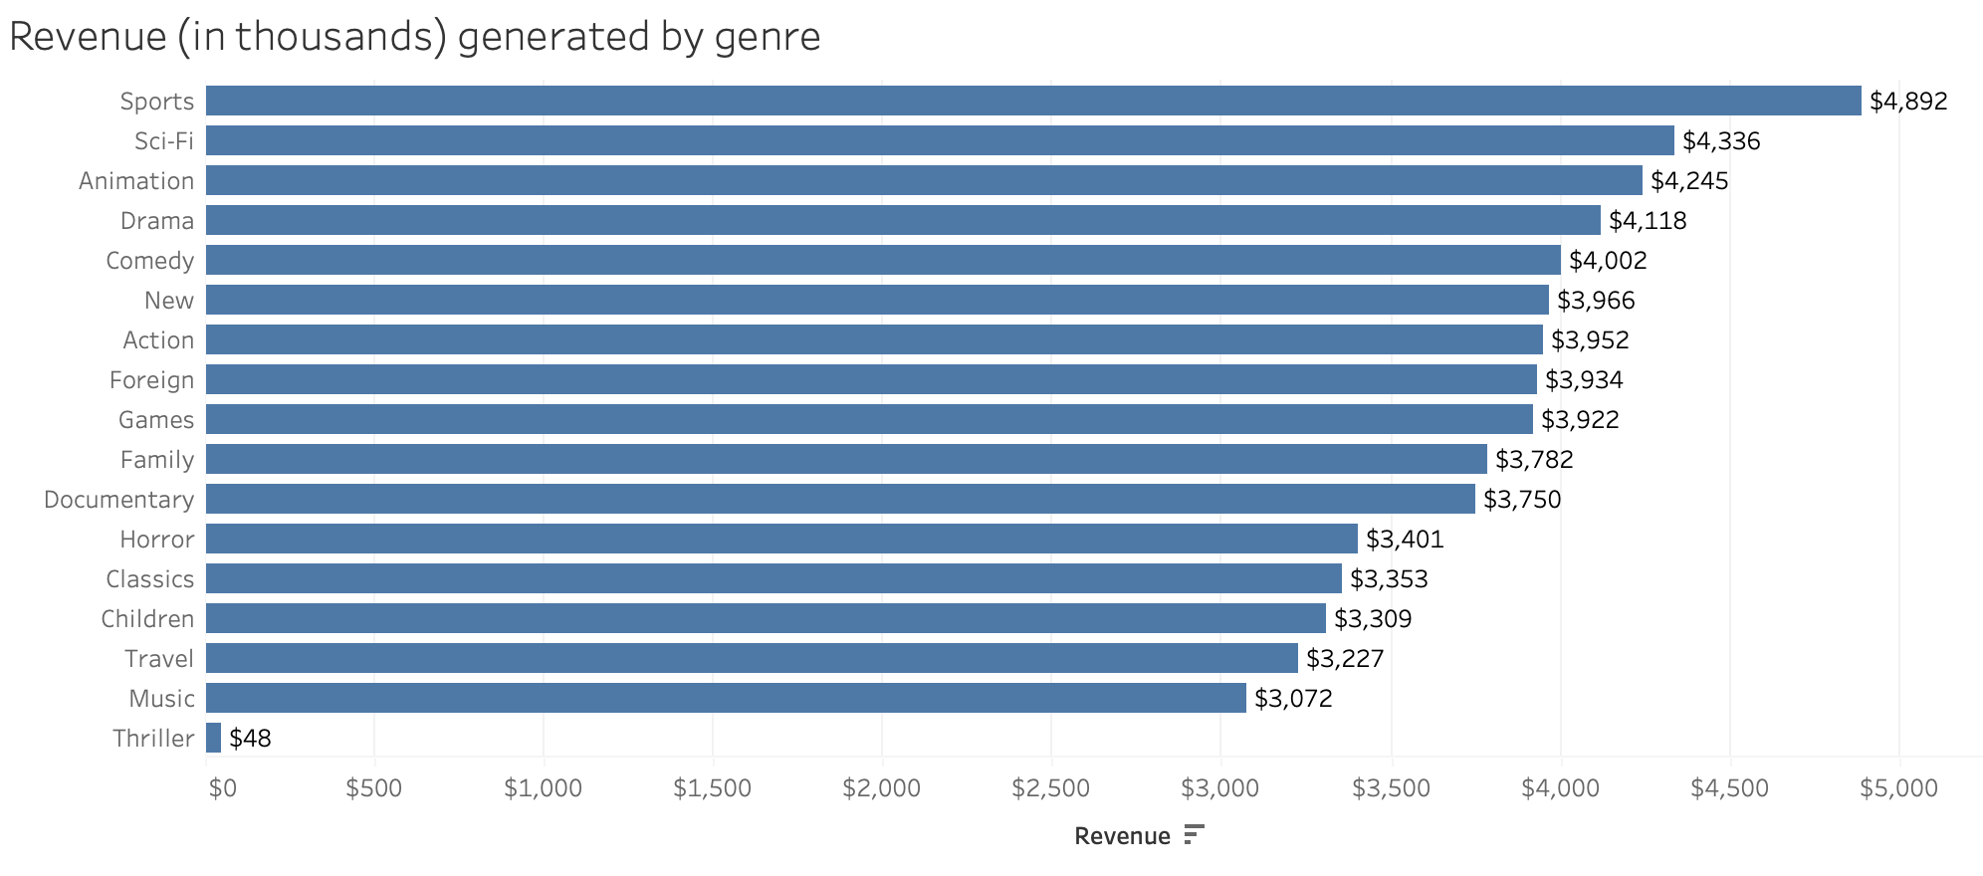
Globally, Sports, Sci-Fi, and Animation generate top sales over $4,200 each; Thriller revenue created significantly less at only $48

Slide 5
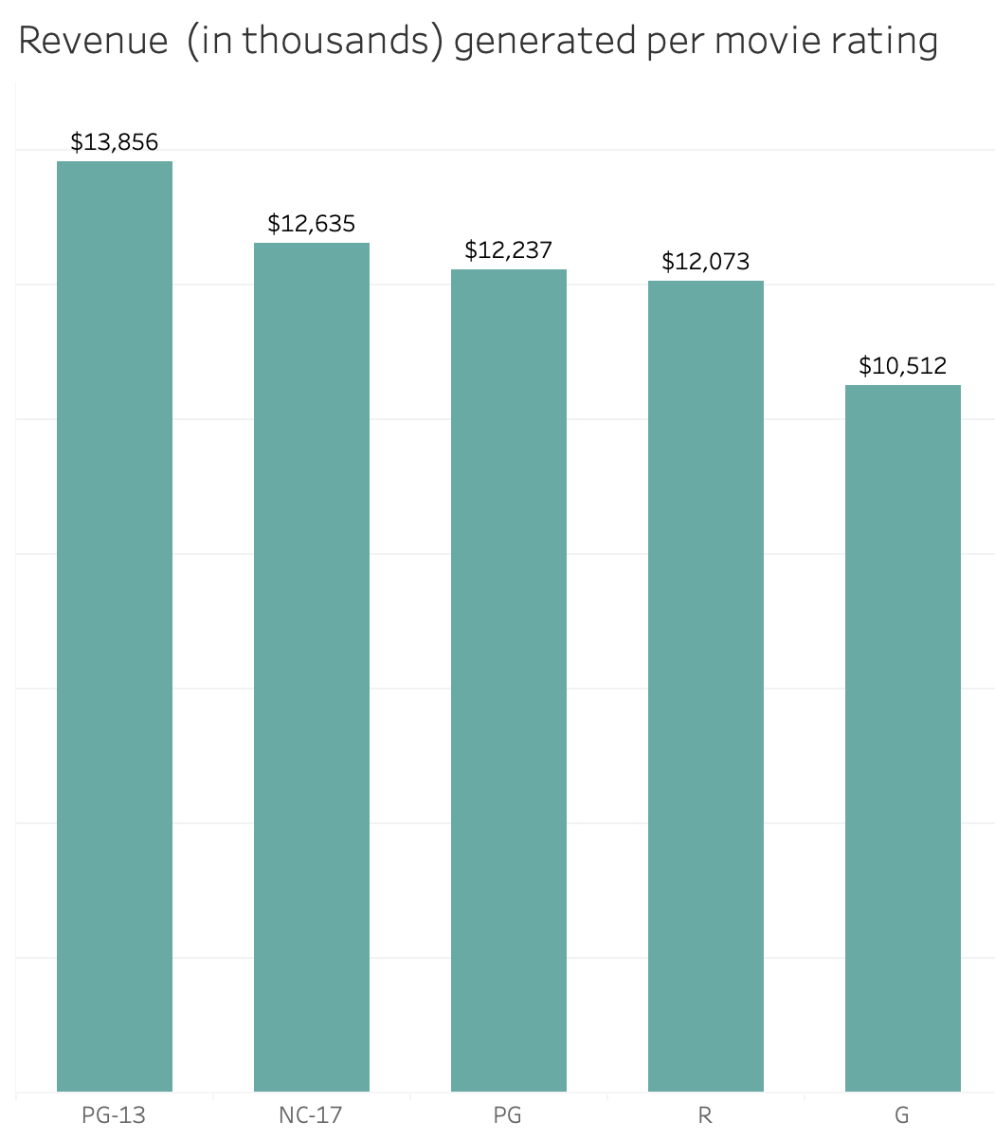
All 5 movie ratings offered by Rockbuster generated at least $10k in sales each PG-13 rating led with almost $14k in sales and G generated the least at $10,512

Slide 6
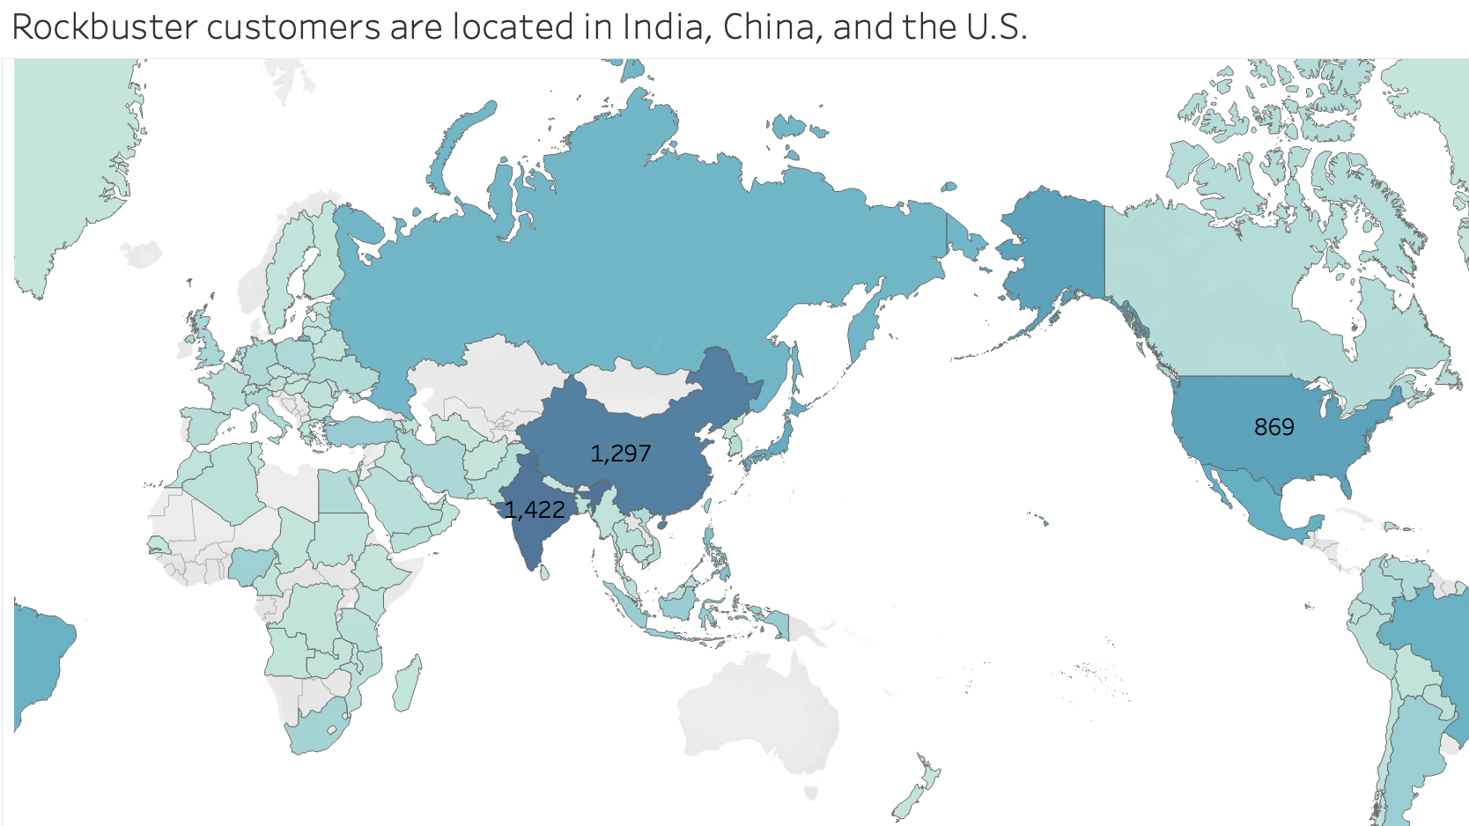
China (1,297 customers)
India (1,422 customers)
U.S. (869 customers)

Slide 7
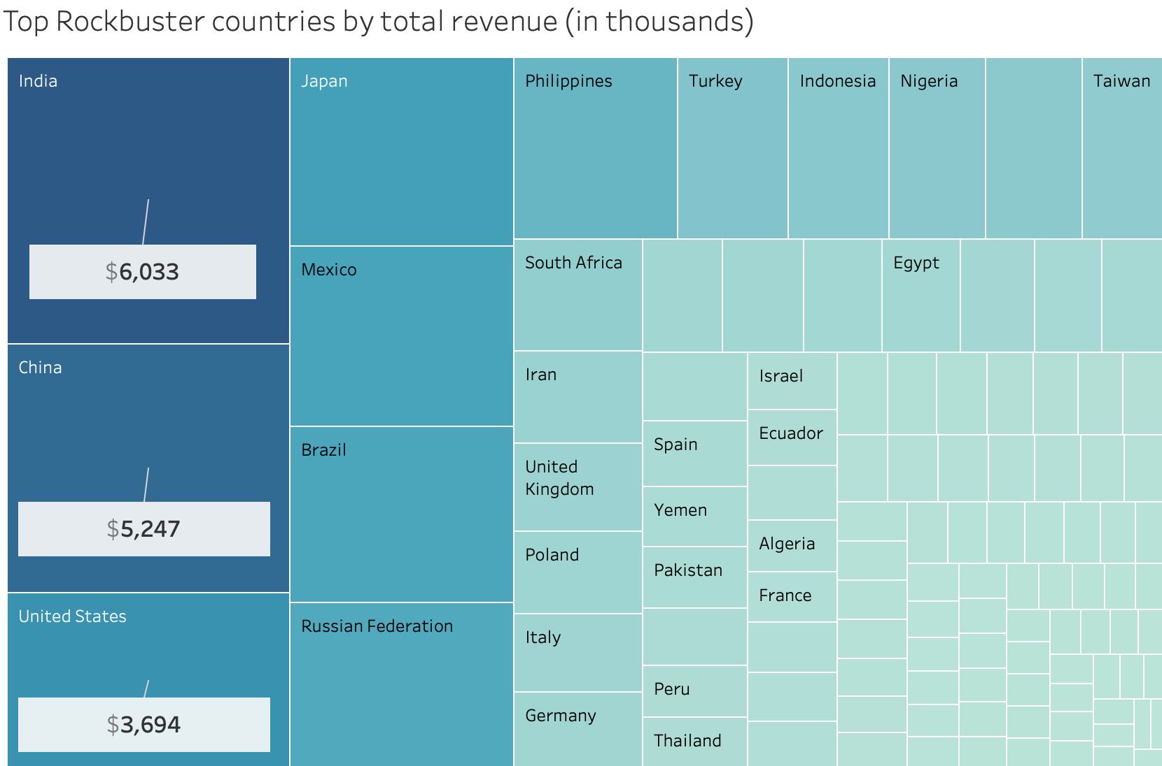
India led in revenue, generating over $6,000 in sales for Rockbuster, followed by China at $5,247 and the United States in third with $3,694 in sales

Slide 8
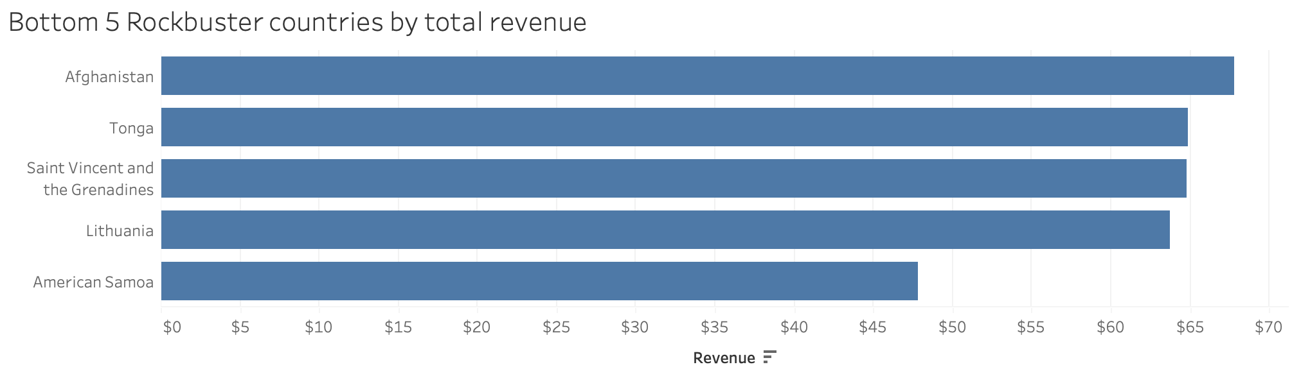
American Samoa produced the least revenue for Rockbuster at only $48

Slide 9
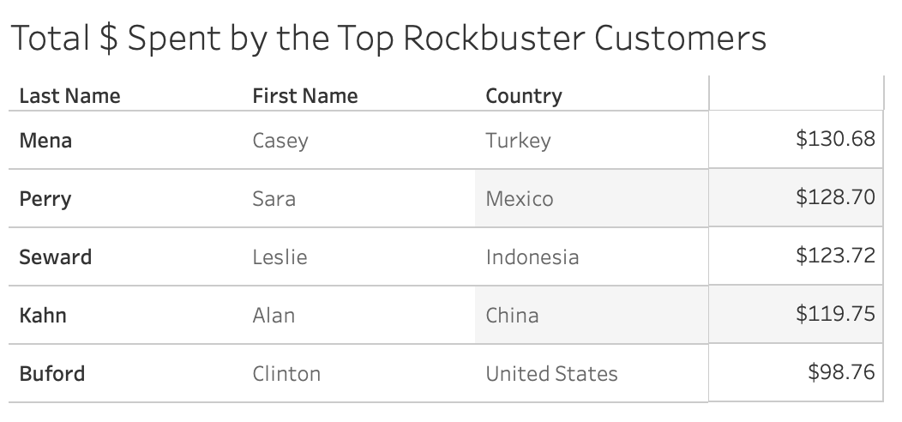
Who are Rockbuster’s top customers?

Slide 10
Recommendations
Add more movies in the genres of Sports, Sci-Fi, and Animation to expand viewing options in the most popular categories; also, address the abnormally low revenue in Thriller genre by removing it altogether or adding better Thriller options
1) Start Rockbuster’s online video rental release in India, China, and U.S. where the revenue is highest; 2) or slow release to bottom 5 countries to address technological problems while financial risk is low, then release to top countries
All 5 movie rating options generated over $10k and only varied between $3,000; PG-13 is technically the most lucrative, but continue adding more of all 5 options
The top 5 Rockbuster customers all live in different countries; consider adding a member rewards program to the top 5-10 customers in order to diversify and build loyalty globally

